Slide 1
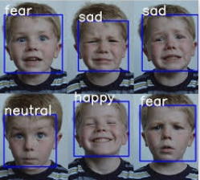
Detection of emotion from facial expression
From Team - “Alpha Z”

Slide 2
Team Members
Name | Project Work
Mainak Ghosh | Model Implementation & PPT Presentation
Soumyabrata Chakraborty | Concept Note Making and PPT Presentation.
Anisha Ghoshal | Concept Note Making, Data Analysis.
Koustav Ghosh | Exploratory Data Analysis, Creation of Model Architecture, PPT Design.
Arpan Mukherjee | Concept Note Making, Design, Testing.

Slide 3

Why Emotion Detection?
The motivation behind choosing this topic specifically lies in the huge investments large corporations do in feedbacks and surveys but fail to get equitable response on their investments.
Emotion Detection through facial gestures is a technology that aims to improve product and services performance by monitoring customer behavior to certain products or service staff by their evaluation

Slide 4



Some Companies that make us of emotion detection
While Disney uses emotion-detection tech to find out opinion on a completed project, other brands have used it to directly inform advertising and digital marketing.
Kellogg’s is just one high-profile example, having used Affectiva’s software to test audience reaction to ads for its cereal.
Unilever does this, using HireVue’s AI-powered technology to screen prospective candidates based on factors like body language and mood. In doing so, the company is able to find the person whose personality and characteristics are best suited to the job.

Slide 5
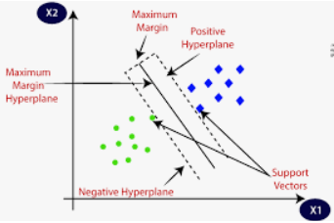
Emotion Expression Recognition Using SVM
What are Support Vector Machines?
SVMs plot the training vectors in high-dimensional feature space, and label each vector with its class. A hyper plane is drawn between the training vectors that
maximizes the distance between the different classes.
The hyper plane is determined through a kernel function (radial basis, linear, polynomial or sigmoid), which is given as input to the classiﬁcation of software.

Slide 6
Facial Expression Detection using Fuzzy ClassifieR
The algorithm is composed of three main stages: image processing stage and facial feature extraction stage, and emotion detection stage.
In image processing stage, the face region and facial component is extracted by using fuzzy color ﬁlter, virtual face model, and histogram analysis method.
The features for emotion detection are extracted from facial component in facial feature extraction stage.

Slide 7
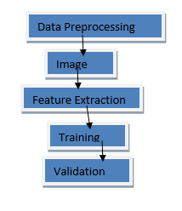
Facial Emotion Recognition by https://drive.google.com/file/d/1kmzU
Steps:
Data Preprocessing
Image Augmentation
Feature Extraction
Training
Validation

Slide 8
Dataset Description
We have downloaded the facial expression recognition (FER) data-set from Kaggle challenge here. The data consists of 48×48 pixel gray scale images of faces. The faces have been automatically registered so that the face is more or less centered and occupies about the same amount of space in each image. The task is to categorize each face based on the emotion shown in the facial expression in to one of seven categories (0=Angry, 1=Disgust, 2=Fear, 3=Happy, 4=Sad, 5=Surprise, 6=Neutral).
Download: https://drive.google.com/file/d/1kmzU
The training set consists of 35,888 examples. train.csv contains two columns, “emotion” and “pixels”. The “emotion” column contains a numeric code ranging from 0 to 6, inclusive, for the emotion that is present in the image. The “pixels” column contains a string surrounded in quotes for each image. The contents of this string a space-separated pixel values in row major order.

Slide 9
Data Preprocessing
The fer2013.csv consists of three columns namely emotion, pixels and purpose.
The column in pixel first of all is stored in a list format.
Since computational complexity is high for computing pixel values in the range of (0-255), the data in pixel field is normalized to values between [0-1].
The face objects stored are reshaped and resized to the mentioned size of 48 X 48.
The respective emotion labels and their respective pixel values are stored in objects.
We use scikit-learn’s train_test_split() function to split the dataset into training and testing data. The test_size being 0.2 meaning, 20% of data is for validation while 80% of the data will be trained.

Slide 10
Train and validation
train_data_dir = '/Users/durgeshthakur/Deep Learning Stuff/Emotion Classification/fer2013/train'
validation_data_dir = '/Users/durgeshthakur/Deep Learning Stuff/Emotion Classification/fer2013/validation'
train_datagen = ImageDataGenerator(
rescale=1./255,rotation_range=30,shear_range=0.3,zoom_range=0.3,width_shift_range=0.4,
height_shift_range=0.4,horizontal_flip=True,fill_mode='nearest')
validation_datagen = ImageDataGenerator(rescale=1./255)
train_generator = train_datagen.flow_from_directory(
train_data_dir,color_mode='grayscale',target_size=(img_rows,img_cols),
batch_size=batch_size,class_mode='categorical',shuffle=True)
validation_generator = validation_datagen.flow_from_directory(
validation_data_dir,color_mode='grayscale',target_size=(img_rows,img_cols),
batch_size=batch_size,class_mode='categorical',shuffle=True)
model = Sequential()

Slide 11
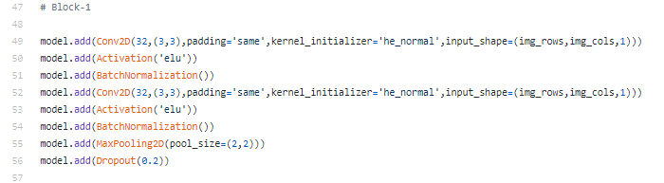
Data Augmentation
More data is generated using the training set by applying transformations. It is required if the training set is not sufficient enough to learn representation. The image data is generated by transforming the actual training images by rotation, crop, shifts, shear, zoom, flip, reflection, normalization etc. Data Augmentation

Slide 12
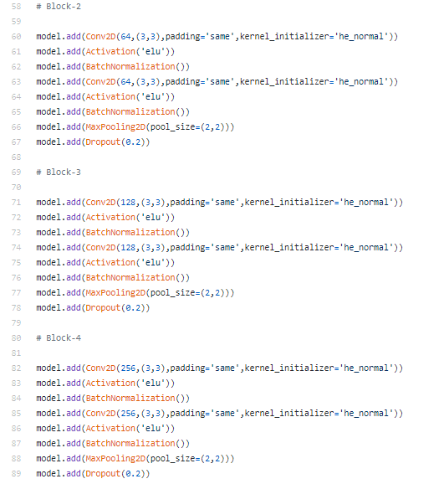

Slide 13
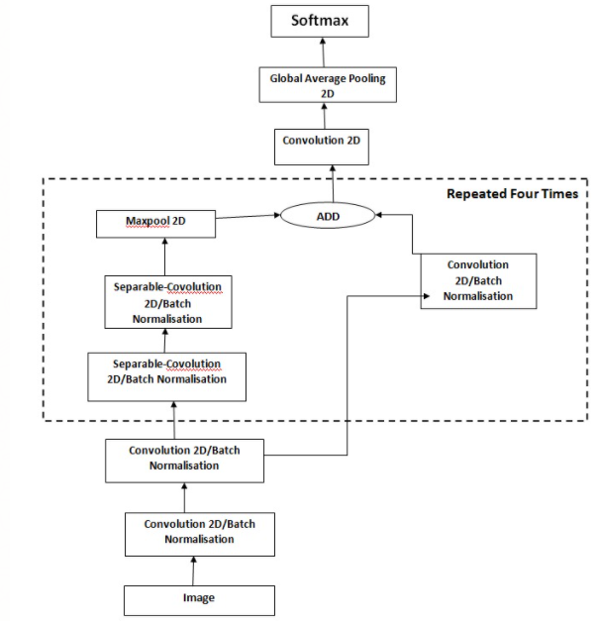
Mini-Exception Model for Emotion Recognition
The architecture of the Mini_Exception model consists of:
● Two convolutional layers followed by batch normalization
● Then one batch is again treated with a convolutional layer and other batch is treated by seperable- convolutional layer.
● The layers are followed my max pooling and global average pooling finalized by the softmax algorithm.

Slide 14
Convolutional 2D
The 2D convolution is a fairly simple operation at heart: you start with a kernel, which is simply a small matrix of weights. This kernel “slides” over the 2D input data, performing an element wise multiplication with the part of the input it is currently on, and then summing up the results into a single output pixel.
--------model.add(Conv2D(256,(3,3),padding='same',kernel_initializer='he_normal'))

Slide 15
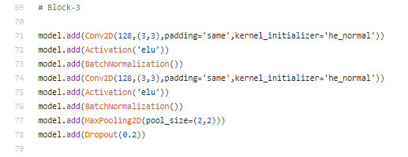
Batch Normalization and Max Pooling 2D
Batch normalization reduces the amount by what the hidden unit values shift around (covariance shift).
In case of Max Pooling, a kernel of size n*n is moved across the matrix and for each position the max value is taken and put in the corresponding position of the output matrix.

Slide 16
Optimizer, Loss function and Metrics.
● Loss function used is categorical cross entropy.
● Loss function simply measures the absolute difference between our prediction and the actual value.
● Cross-entropy loss, or log loss, measures the performance of a classification model whose output is a probability value between 0 and 1. Cross-entropy loss increases as the predicted probability diverges from the actual label. So predicting a probability of .012 when the actual observation label is 1 would be bad and result in a high loss value.

Slide 17
Continue…
Optimizer used is the Adam() optimizer.
Adam stands for Adaptive Moment Estimation. Adaptive Moment Estimation (Adam) is another method that computes adaptive learning rates for each parameter. In addition to storing an exponentially decaying average of past squared gradients like AdaDelta ,Adam also keeps an exponentially decaying average of past gradients M(t), similar to momentum:

Slide 18
Validation
● In the validation phase, various OpenCV functions and Keras functions have been used.
● Initially the video frame is stored in a video object.
● An LBP cascade classifier is used to detect facial region of interest
● The image frame is converted into grayscale and resized and reshaped with the help of numpy.
● This resized image is fed to the predictor which is loaded by keras.models.load_model() function.
● The max argument is output.
● A rectangle is drawn around the facial regions and the output is formatted above the rectangular box.

Slide 19
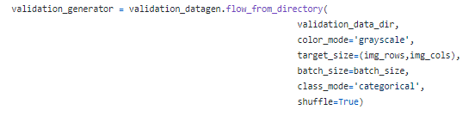
Validation codes

Slide 20
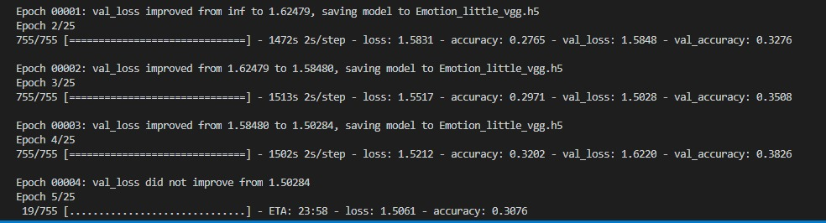
Performance Evaluation
The model gives 65-66% accuracy on validation set while training the model. The CNN model learns the representation features of emotions from the training images. Below are few epochs of training process with batch size of 64.

Slide 21
Conclusion
Finally, this project will helpful for the detection of facial expressions using deep learning convolution neural network and Keras library. Deep learning helps us to create such amazing software by which we can easily detect facial expressions through a webcam in real-time. Here we have used 35000+ data sets to execute our program, if we increase the amount of data in the data set then the output will be more accurate. In robot science, this technology helps the bot to easily identify human emotions in real-time and give a quick reply to them.

Slide 22


